Slide 1
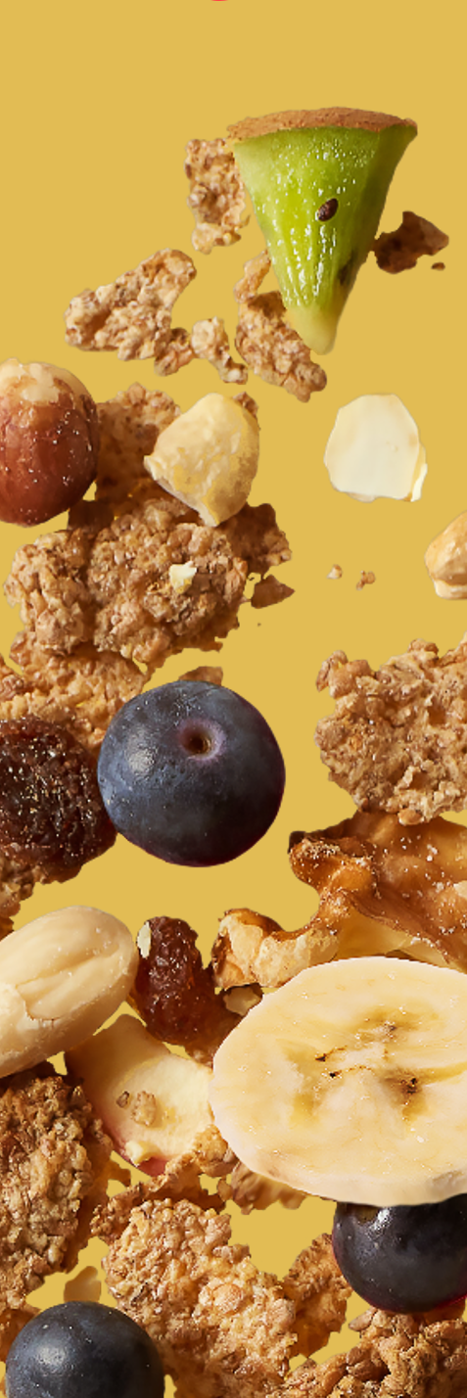
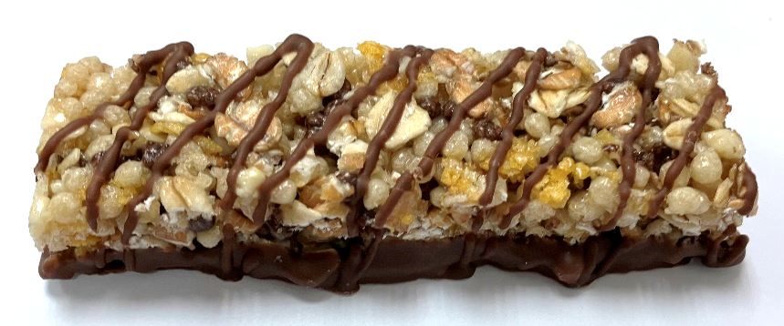

muesli bar with whole milk chocolate and peanuts (fts)
REF.: 000004010804
Ingredients |  | In %
whole milk chocolate | sugar, whole MILK powder, cocoa butter, cocoa mass, emulsifier: lecithins | 24,0
glucose-fructose syrup |  | 17,0
cereal extrudate | WHEAT flour, rice flour, BARLEY malt flour, sugar, maize flour, salt | 11,1
whole grain OAT flakes |  | 10,9
whole grain WHEAT flakes |  | 10,9
glucose syrup |  | 10,5
chopped, roasted PEANUTS |  | 3,7
cereal cocoa extrudate | WHEAT flour, rice flour, maize semolina, fat reduced cocoa powder, BARLEY malt flour, salt | 3,7
sweetened cornflakes | maize, sugar, salt, BARLEY malt extract, emulsifier: lecithins | 3,7
coconut fat |  | 2,4
honey |  | 1,0
humectant: glycerol
emulsifier: lecithins
salt
Nutrition information | per 100g | per bar (25g)
kJ calories | 1819 433 | 455 108
Fat (g) of which saturates (g) | 15,1 7,2 | 3,8 1,8
Carbohydrates (g) of which total sugars (g) | 64,6 28,2 | 16,2 7,0
Fibre (g) | 4,3 | 1,1
Protein (g) | 7,6 | 1,9
Salt (g) | 0,40 | 0,10
Description of product :
This bar is a mixture of cereals, whole grain flakes, whole milk chocolate and other ingredients. After homogenisation and forming the ingredient mass is cut into portions and the base is covered with milk chocolate.
Claims :
source of fibre (needs to be verified by analysis)
Allergen information :
Contains allergens according to the list of ingredients. Manufactured in a facility where the following allergens are present: cereals containing gluten, peanuts, sesame, nuts, milk and soya products, mustard, lupin.
Storage conditions :
12 months in original package at temperatures below 20 °C and less than 60 % relative air humidity

